Slide 1
GHG EMISSIONS FUEL
Harvesting the Power of Artificial Intelligence for a Sustainable Future

Slide 2
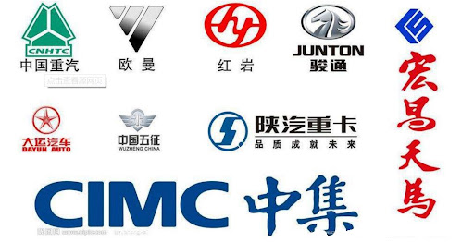
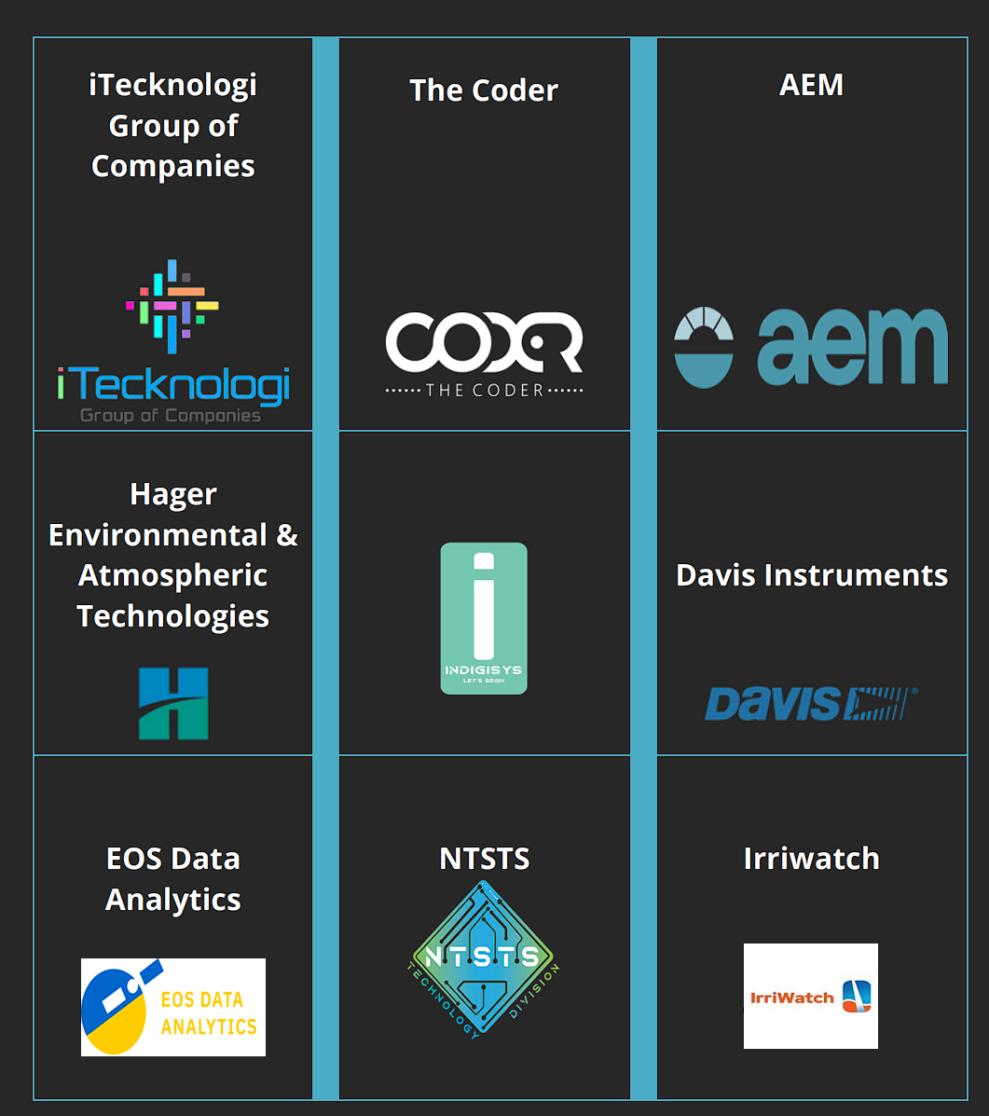
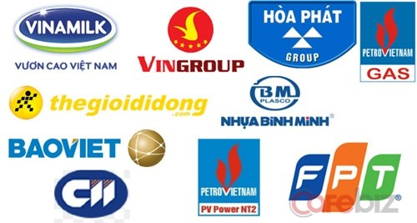
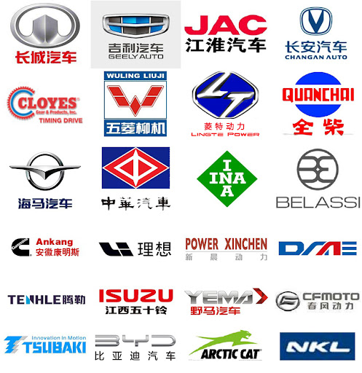
GLOBAL CLIENTS & PARTNERS

Slide 3
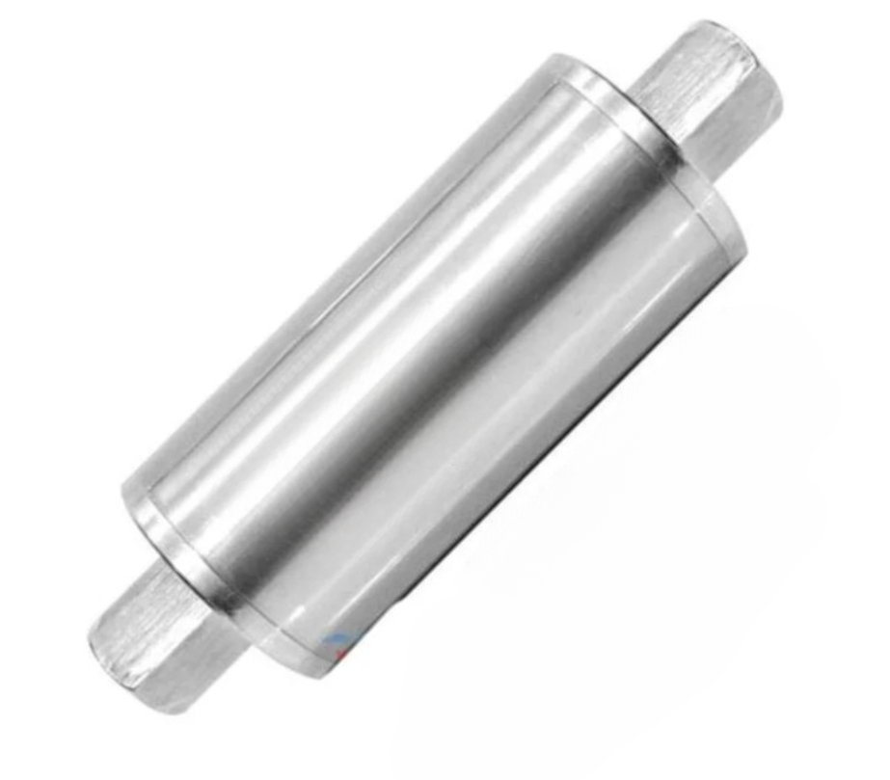
"AI-Based Technology for Reducing Greenhouse Gas Emissions and Enhancing Fuel Efficiency."

Slide 4
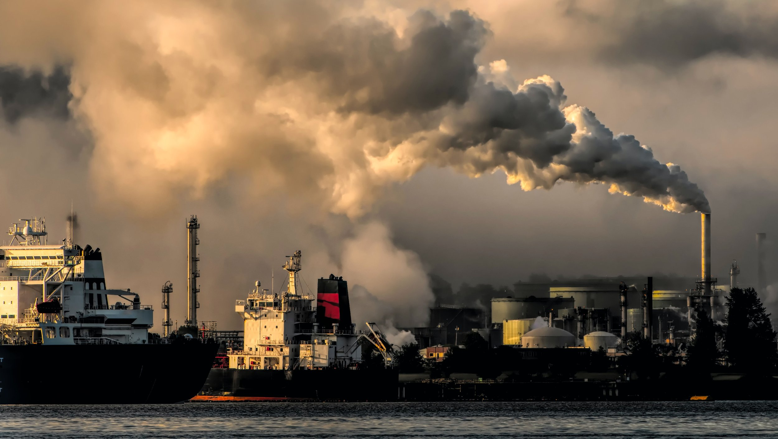
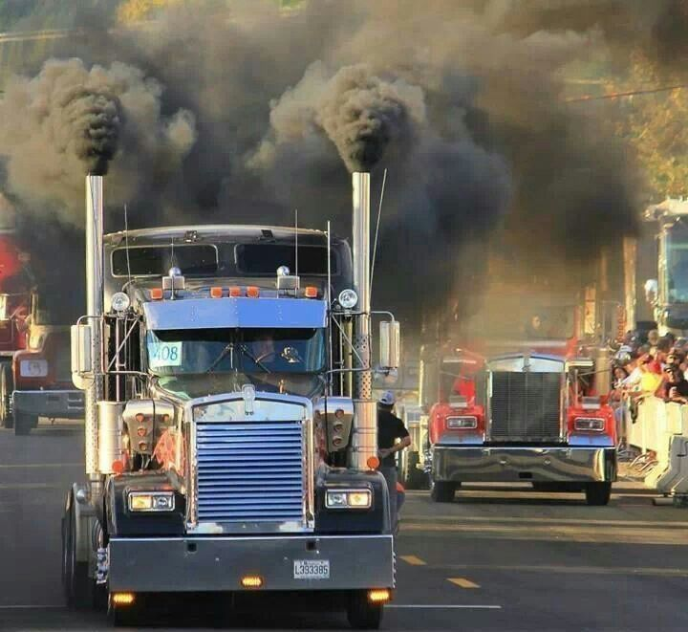
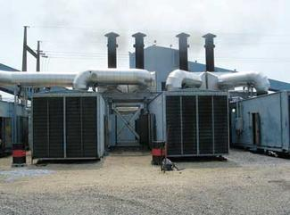
Are you tired of wasting fuel's energy as heat & GHG Emissions? Ai Fuel Regenerator has a solution!
Say hello to a more efficient future with Fuel Regenerator and wave goodbye to wasted energy.

Slide 5
The Ai Fuel Regenerator is a revolutionary 360 solution that can significantly improve emissions and reduce liquid fuel usage. It uses a unique combination of emissions data solution and regenerative elements for liquid fuel, resulting in a much more efficient fuel utilization rate, which ultimately leads to a significant reduction in emissions.
Our fuel enhancement system has been proven in 15+ countries to lower fuel usage and greenhouse gas emissions. It cuts tailpipe emissions by 10%-50% and reduces engine fuel usage by up to 25%. We provide live fuel and emissions data, AI-based analytics and insights, while also decreasing engine upkeep and increasing engine life.
Upto 10-year craftsmanship warranty*
Liability insurance up to 4 million USD*
No service or preventive service is required *
Install and forget solution
Can be installed by trained personnel in under 2 hours*
Field Proven*
Client recommended*
Tested on major engine manufacturers CAT, CUMMINS, DETROIT DIESEL, RENAULT*

Slide 6
Industrial applications
Mining sector
Transportation sector
Industrial sector
Agriculture sector
Aviation sector
Marine sector
Offshore sector
Oil & Gas sector

Slide 7
Ai BASED Working principle

Slide 8
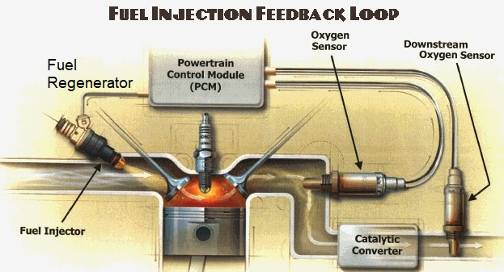
a 360-degree approach to GHG emissions reduction
Bypassing liquid fuel through the Fuel Regenerator, you can utilize up to 70%+ more energy. Our AI-based passive element Analyzer analyzes your fuel in real time and reconfigures its profile to create better fuel efficiency& reduce GHG emissions while creating a more sustainable fuel use.
Say hello to a more efficient future with Fuel Regenerator and wave goodbye to wasted energy.

Slide 9
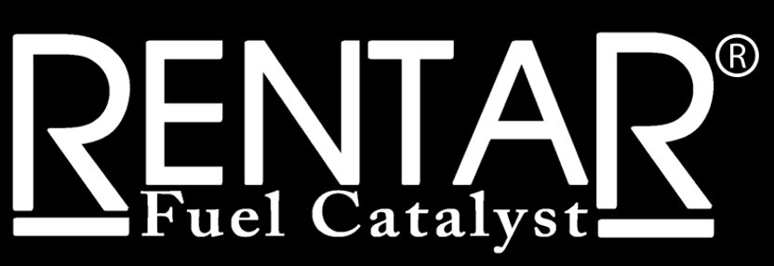
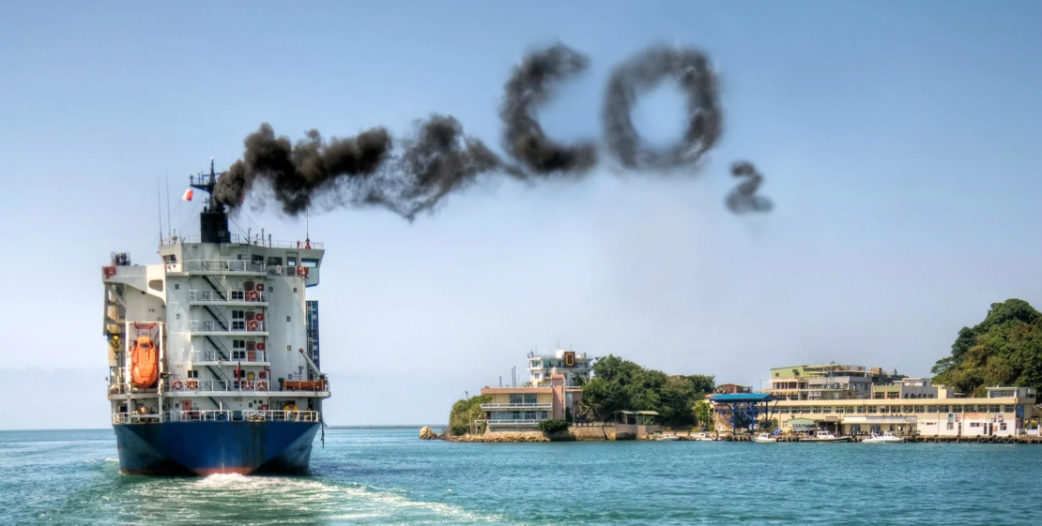
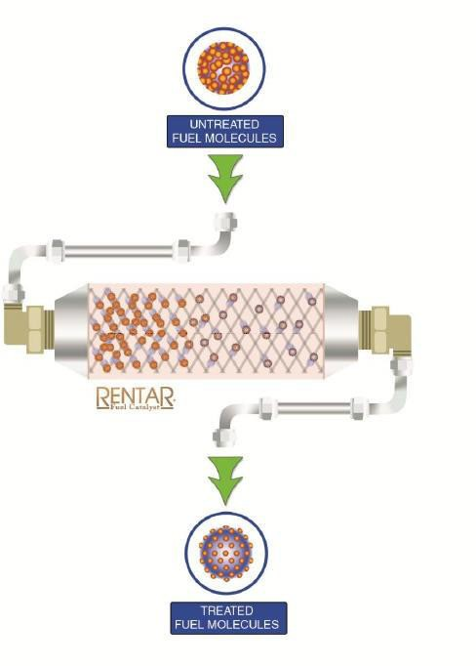
Technology Behind Rentar Fuel Catalyst Device
Before Treatment
Diesel fuel molecules have a natural tendency to
cluster. Clustered molecules do not burn completely
After Treatment
The fuel can disperse and atomize better creating a cleaner and more efficient burn and hence reducing GHG emissions and lowering the fuel consumption

Slide 10
The Fuel Regenerator, also known as the 'Onboard Mini Refinery', is a revolutionary technology that uses a facilitator made of Heterogeneous Metallic Alloy Composition (HMAC). It cracks aromatic hydrocarbon molecules, resulting in better fuel quality, up to 25% fuel savings, reduced carbon footprint and lowered emissions.
Say hello to a more efficient future with Fuel Regenerator and wave goodbye to wasted energy.

Slide 11
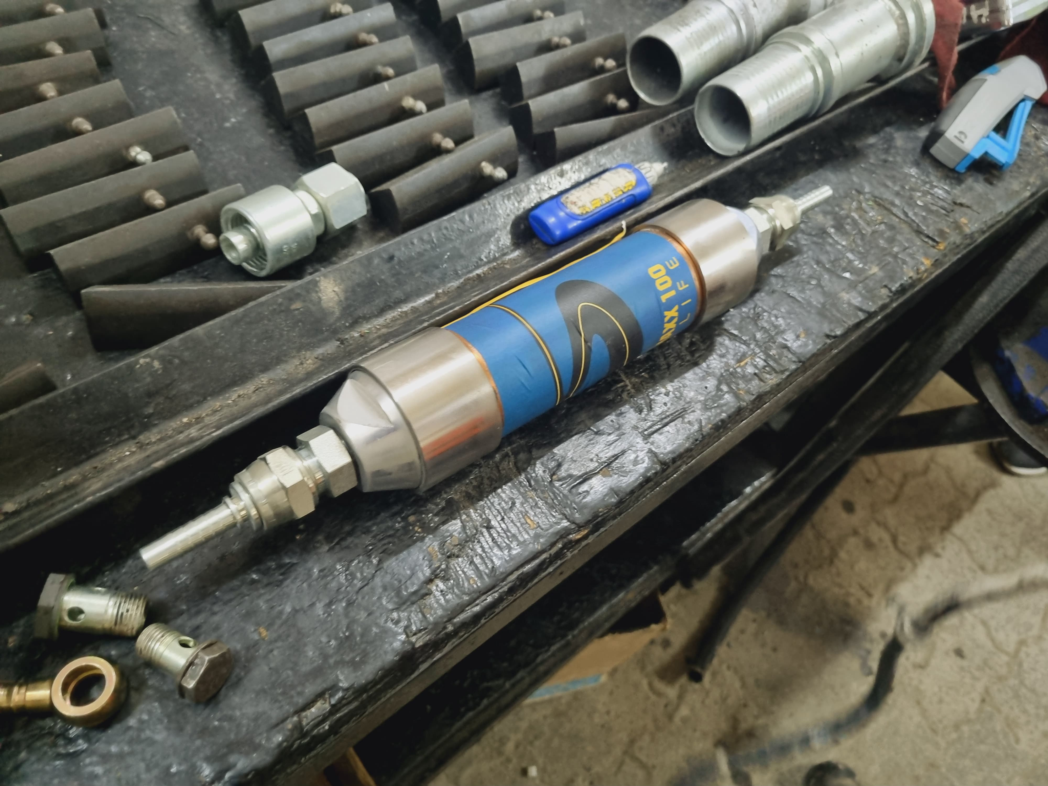
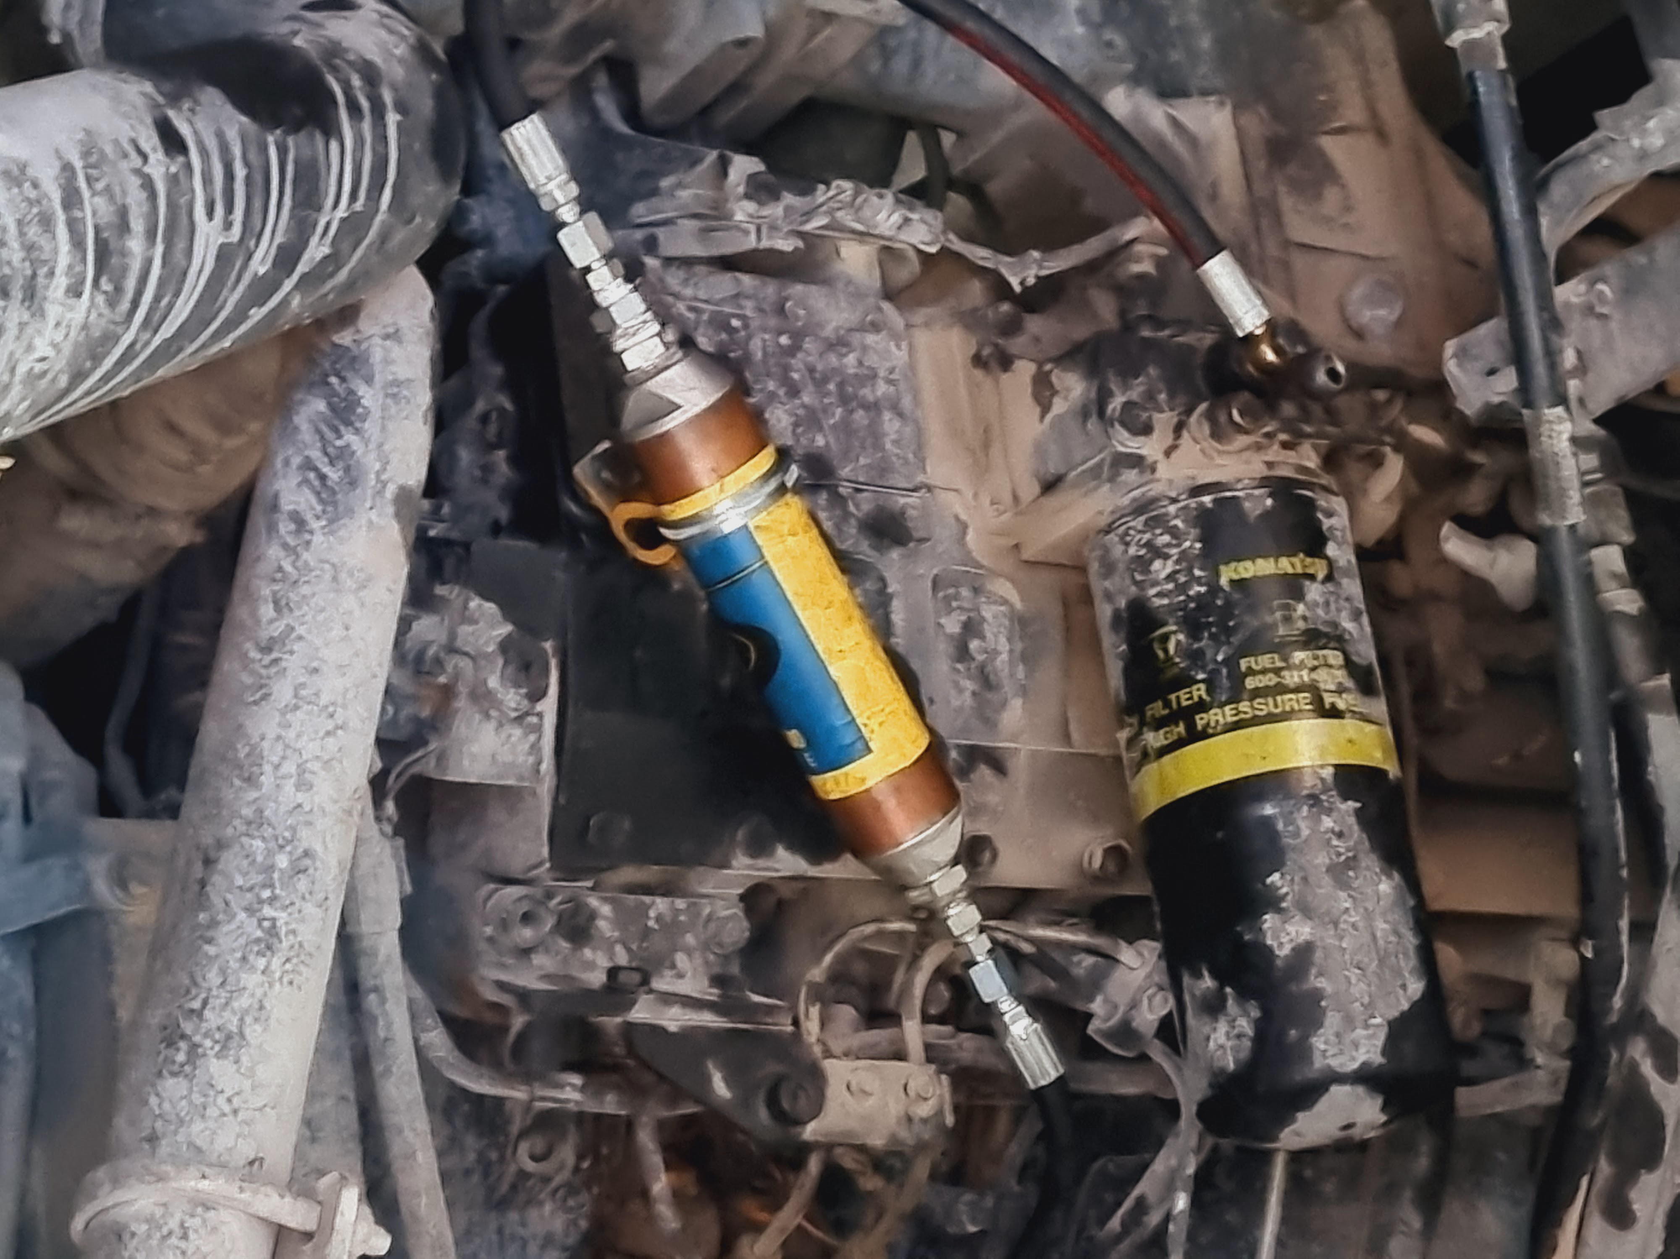
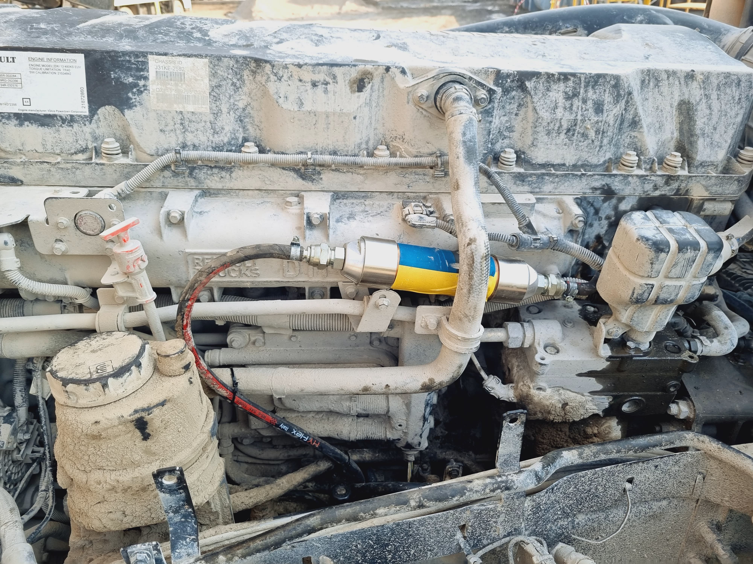
Installation examples

Slide 12
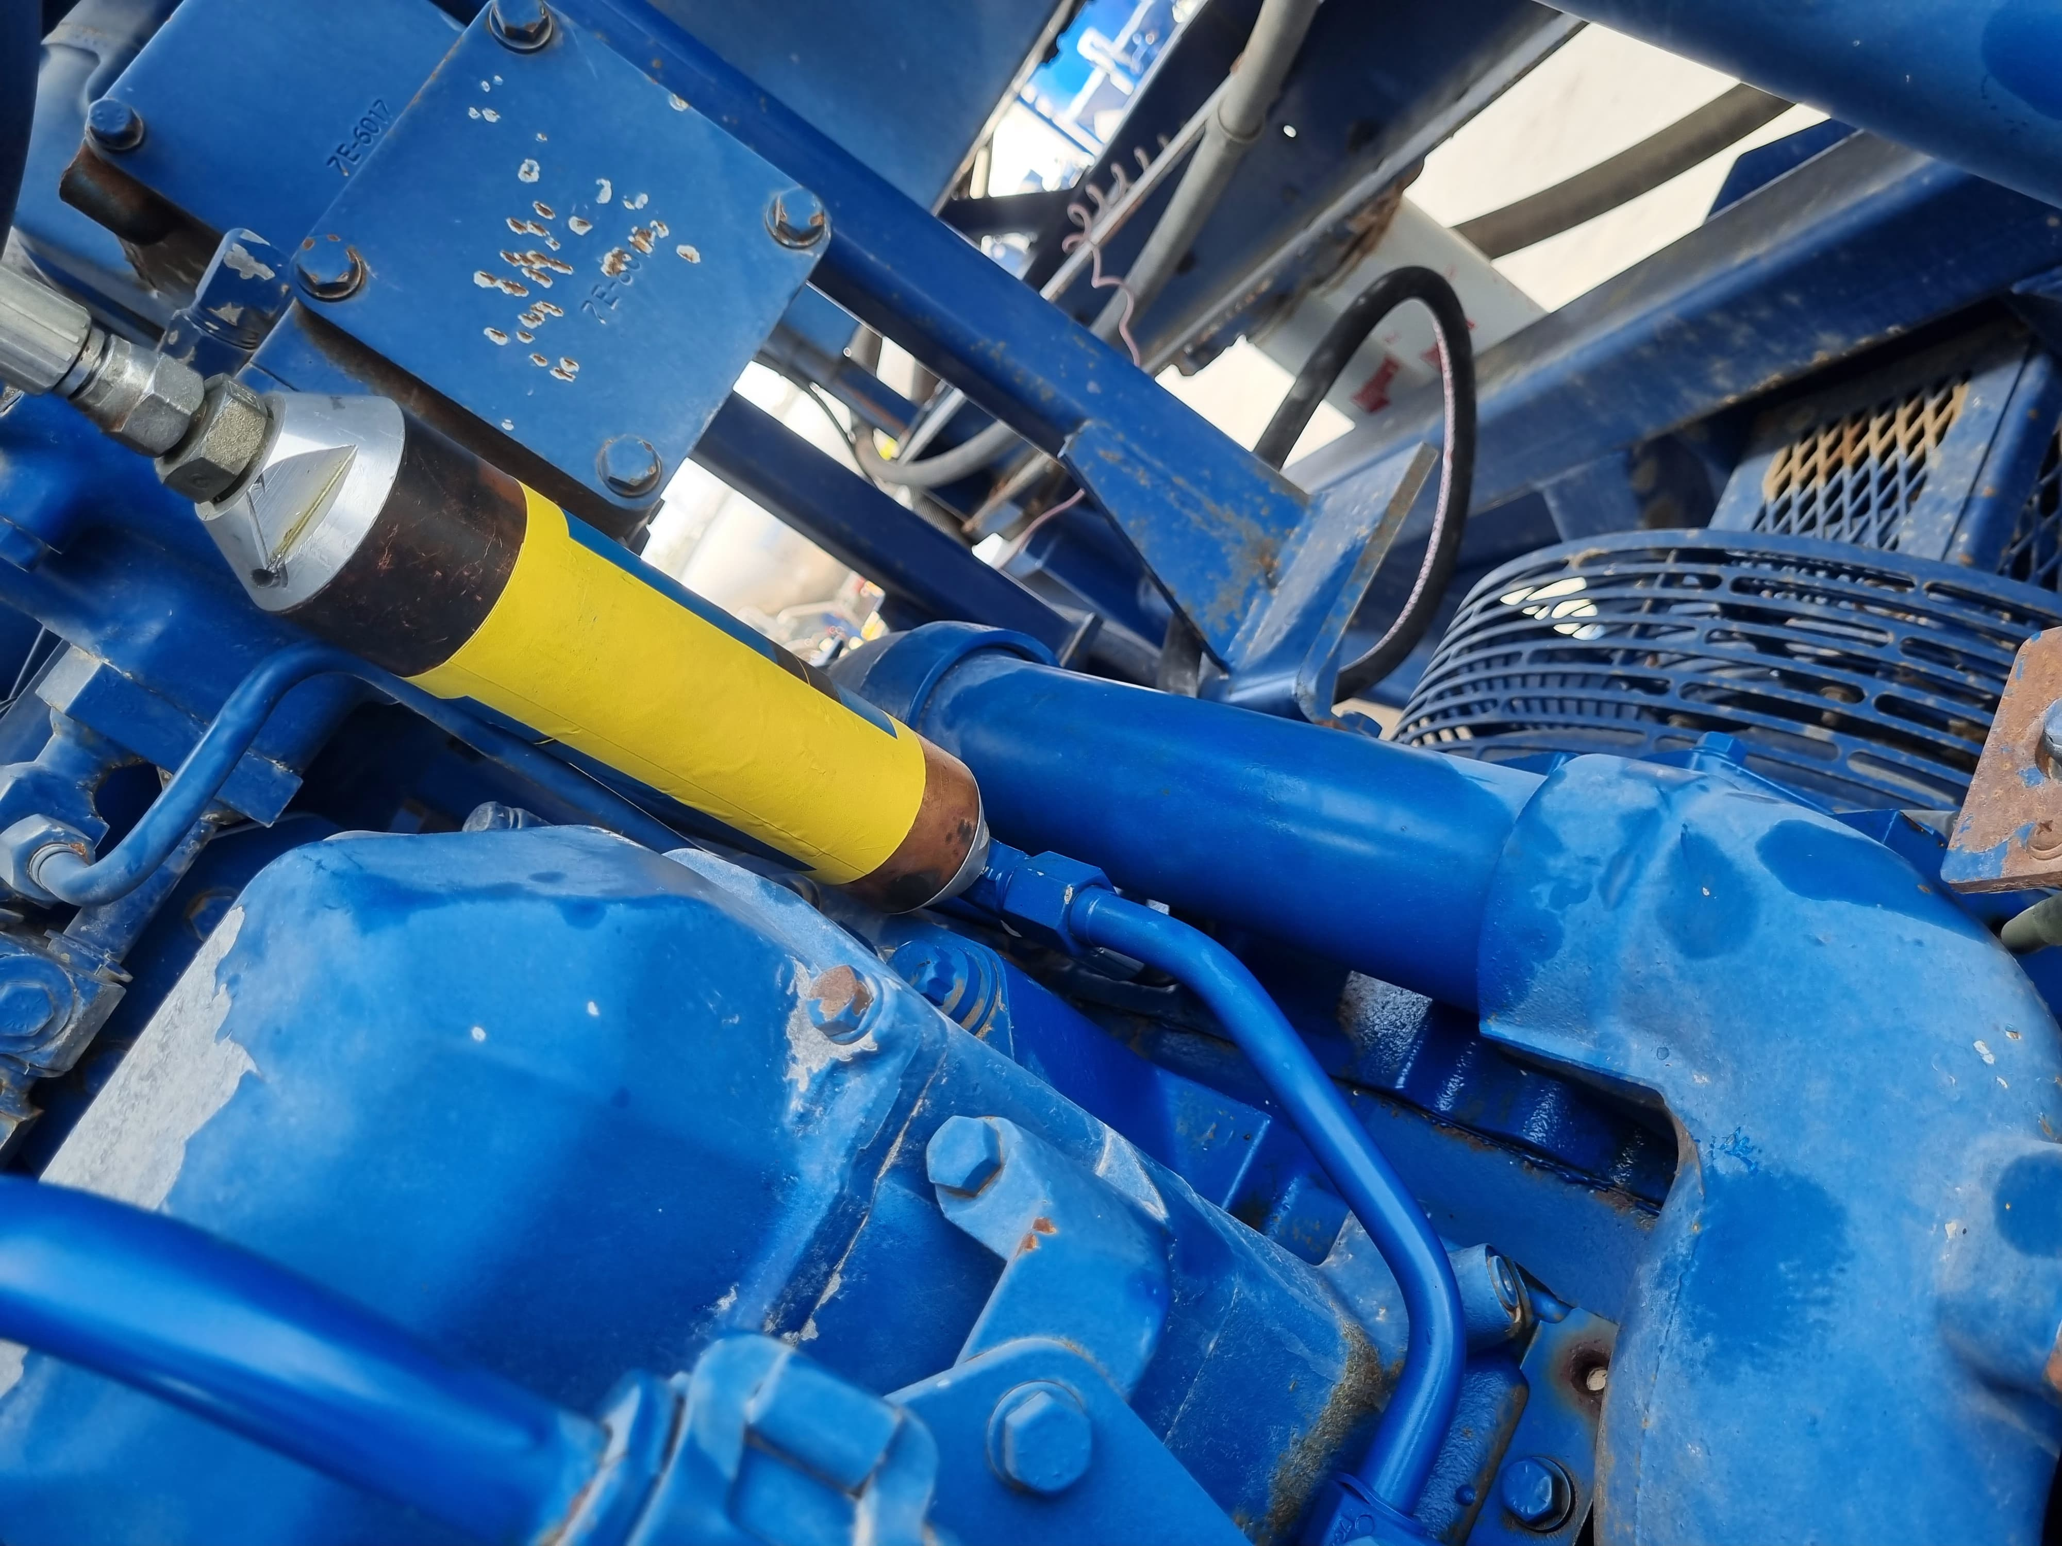
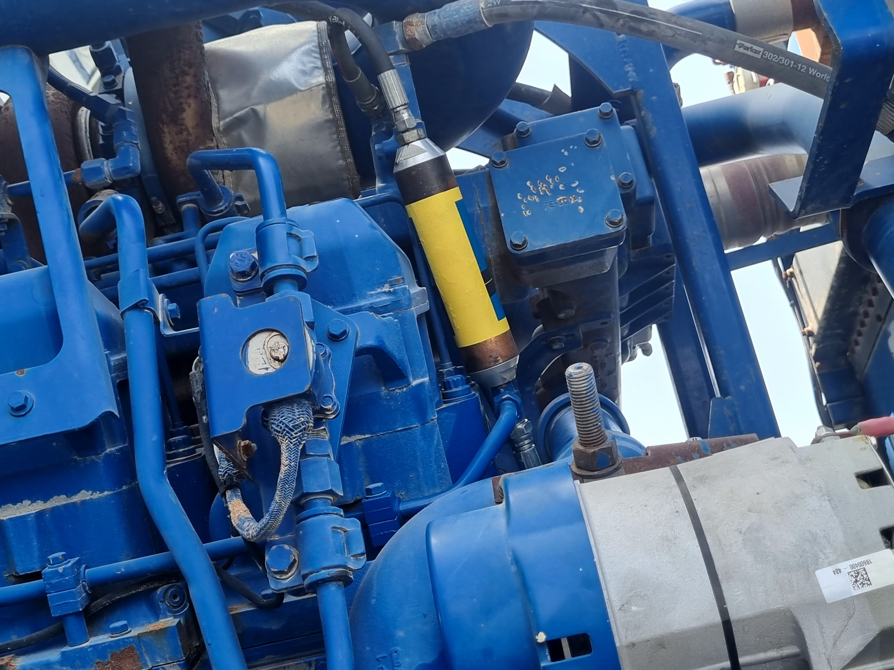
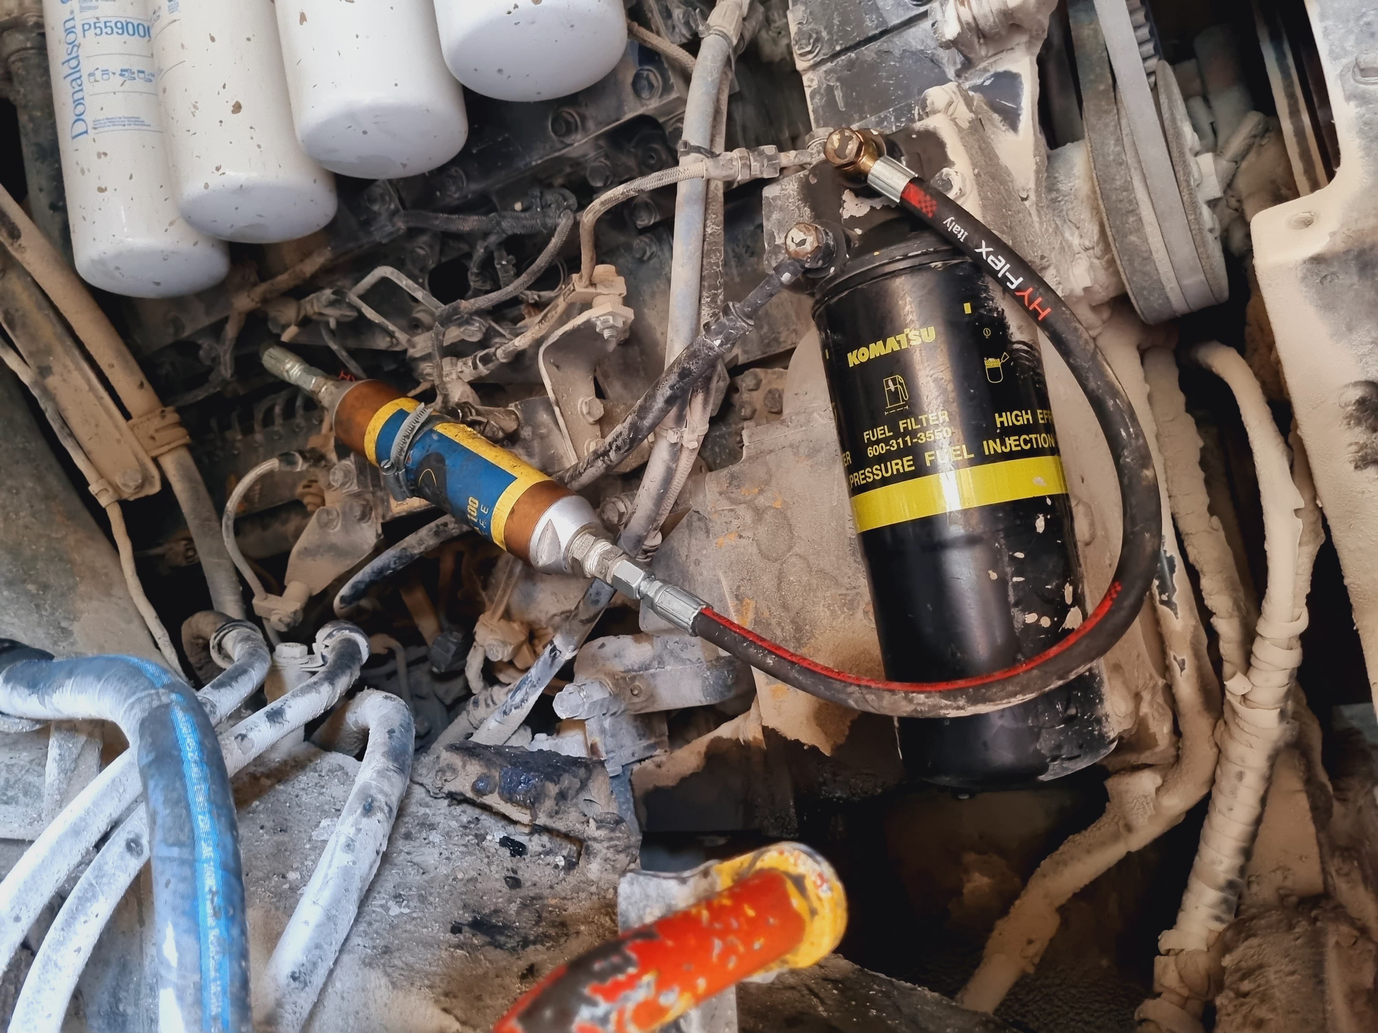
Installation Examples

Slide 13
THANK YOU
References available upon request
Edward Breen
Sales Manager
T: 719-500-7200
C: 719-640-3189
E: eddybreen@roiglobaltech.com
10502 Odin Dr.
Colorado Springs, CO 80924

